Slide 1
Production Maintenance
Express Setup AuthorizeItemStore Mockup
Created by VODC

Slide 2
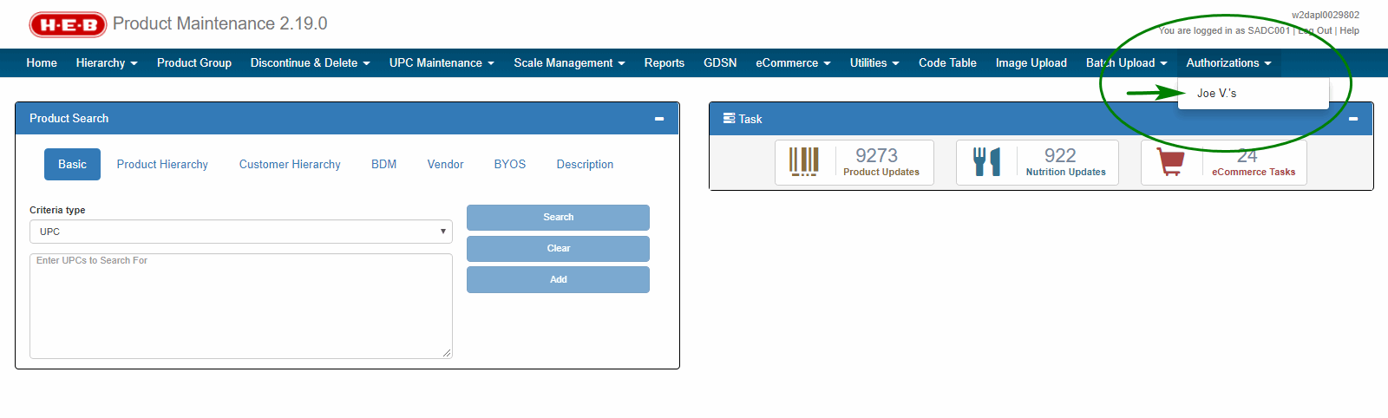
Notes:
In Product Maintenance Home page, there is a new top-level menu item "Authorizations" with a sub-menu item of "Joe V.'s“.

Slide 3
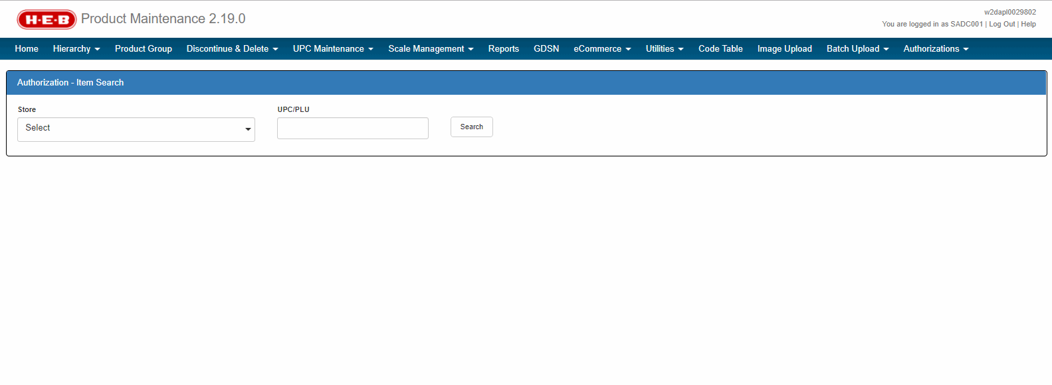
Notes:
When user clicks on sub-menu item of “Joe V.'s”, show Authorization – Item Search screen with a Store drop-down, a UPC/PLU textbox and a Search button.

Slide 4
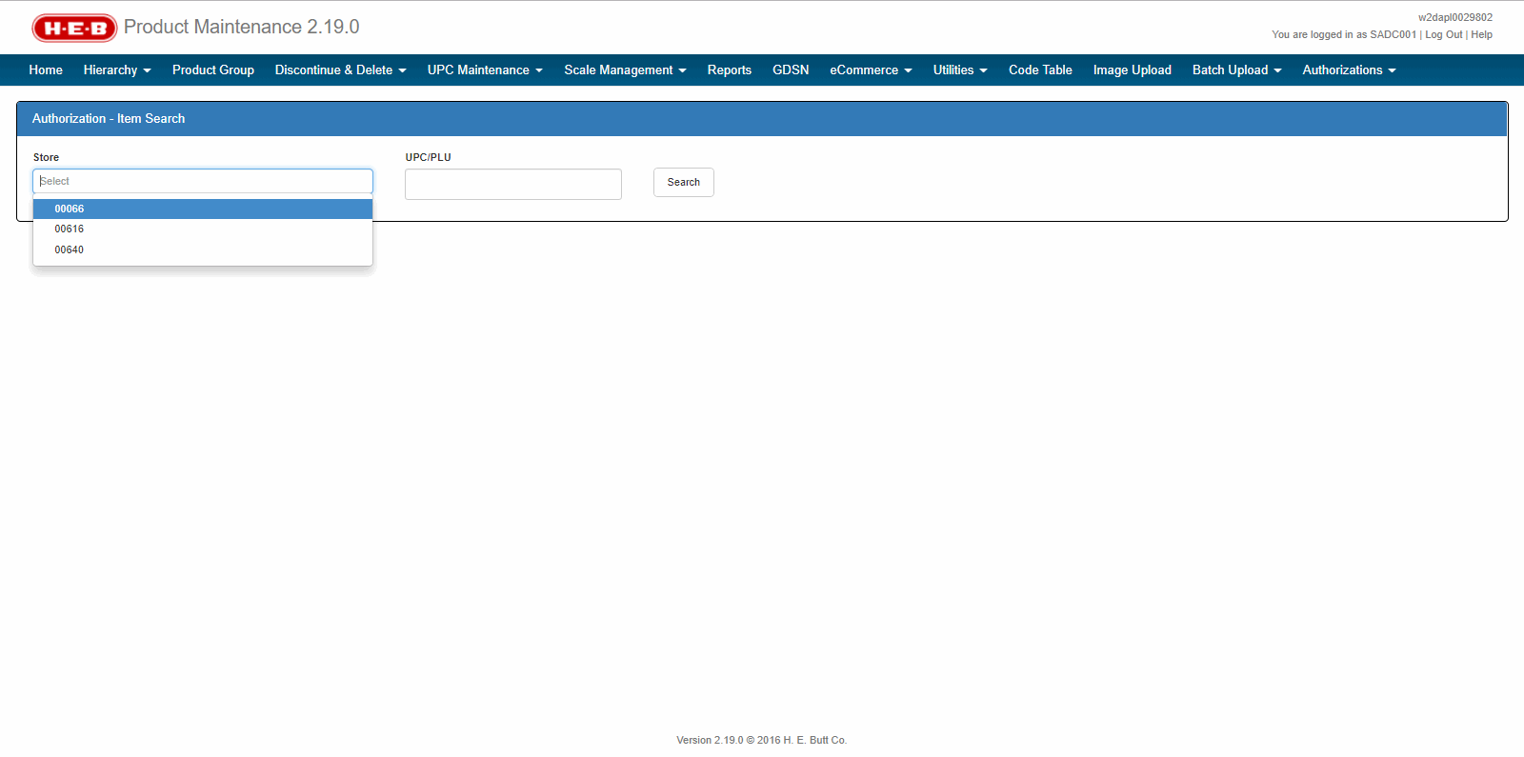
Notes:
Store drop-down option being “ 00066”, “00616”, “00640”.

Slide 5
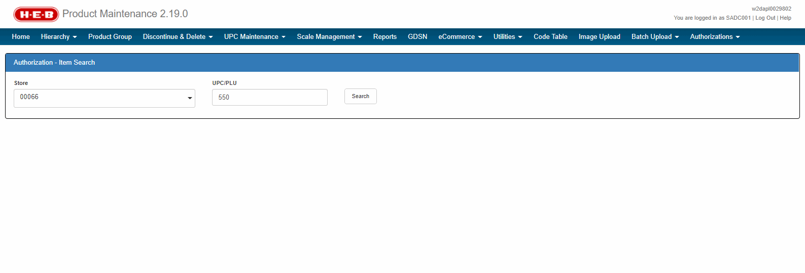
Notes:
When user clicks on “Search” button, list all the Items tied to that UPC/PLU in selected Store.

Slide 6
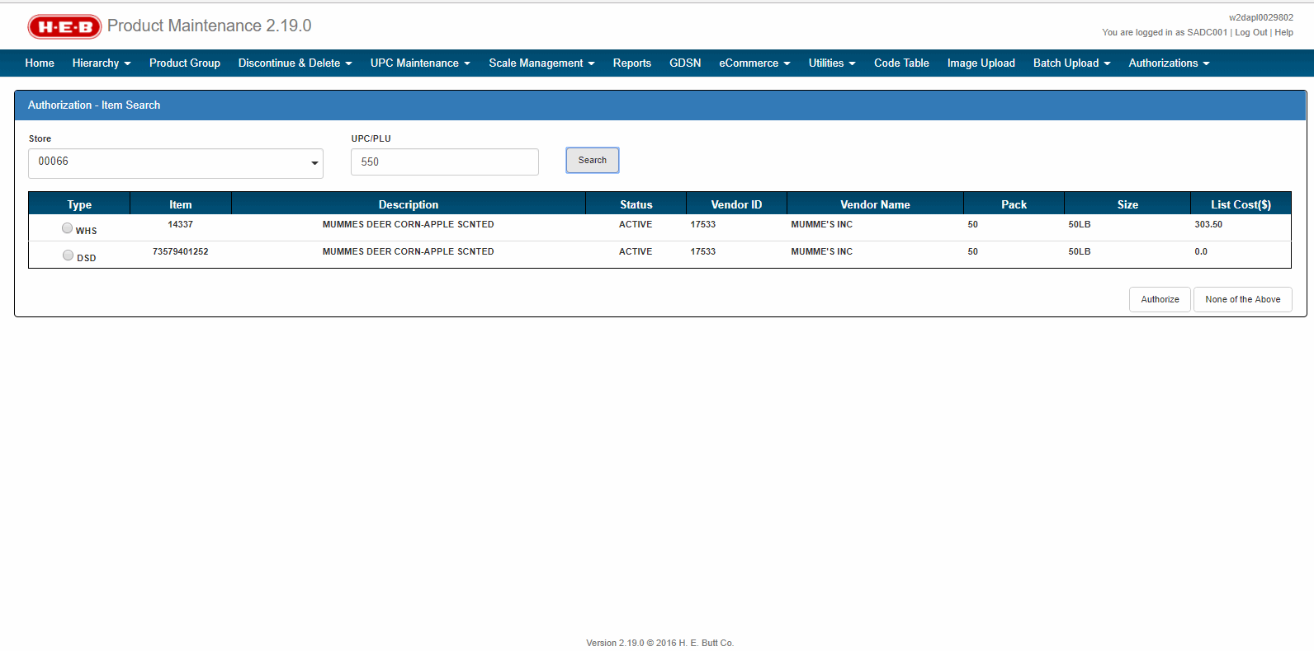
Notes:
List all the Items tied to that UPC/PLU in selected Store.

Slide 7
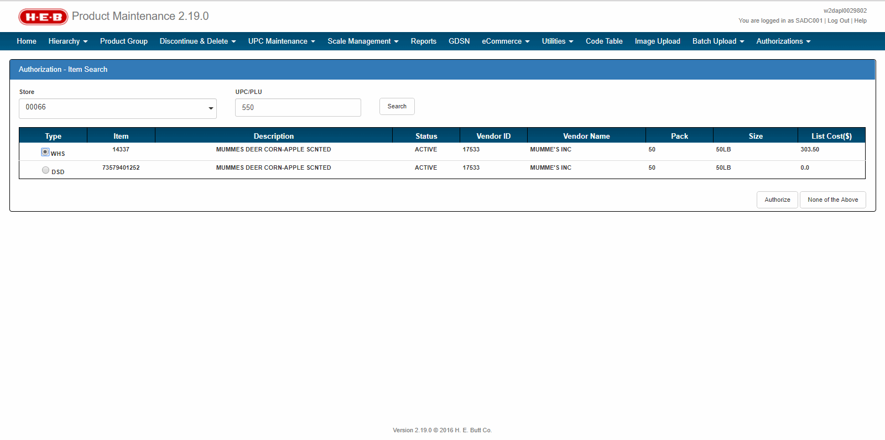
Notes:
Allow user to select an item to authorize.

Slide 8
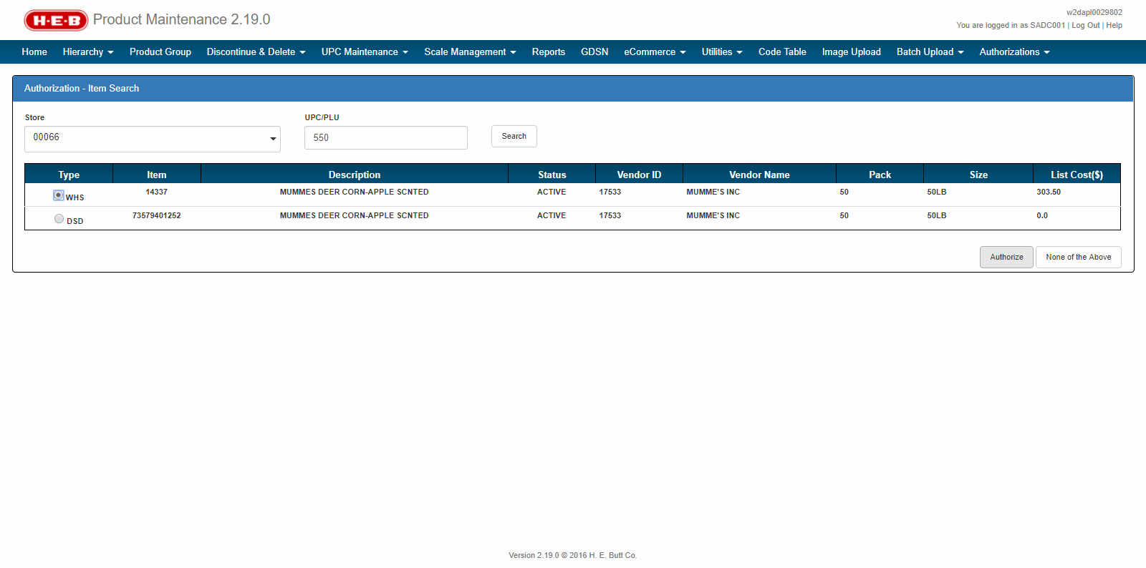
Notes:
When user clicks on “Authorize” button, show Authorization – Authorization screen.

Slide 9
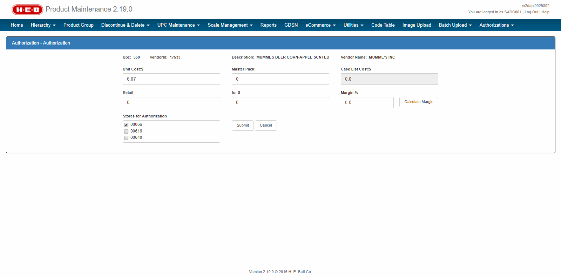
Notes:
Authorization – Authorization screen.

Slide 10
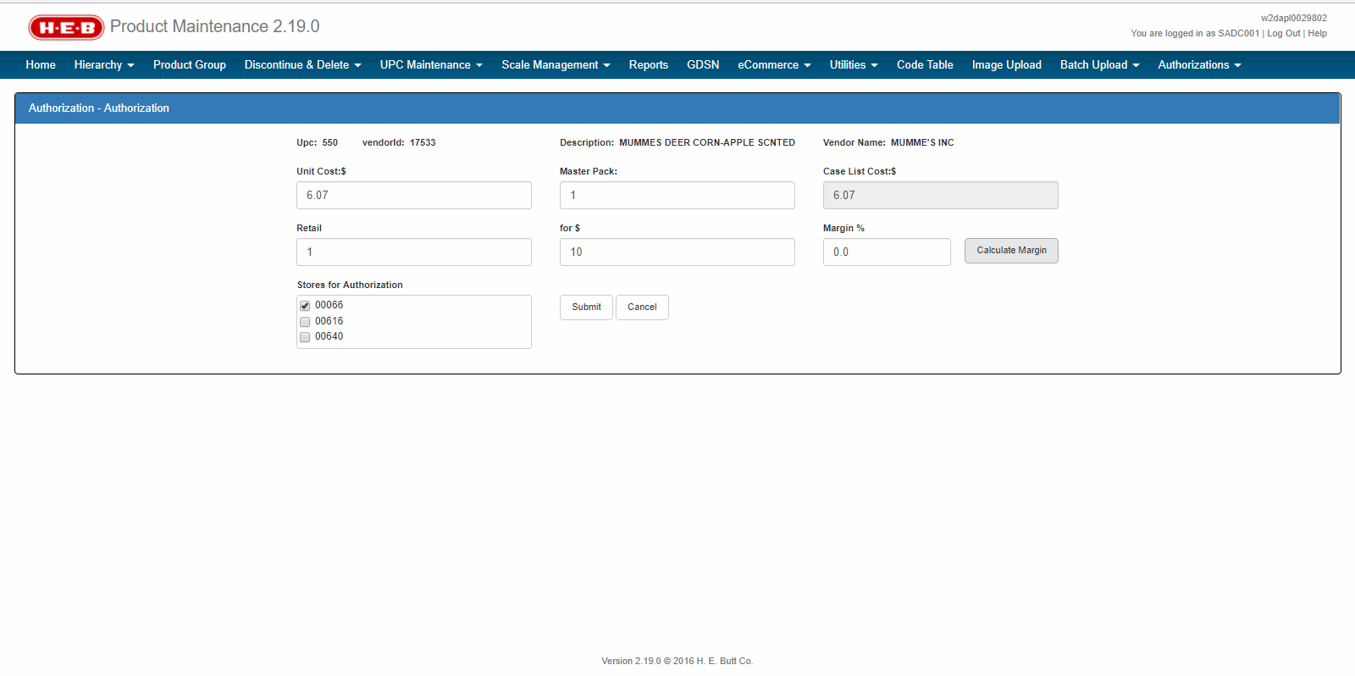
Notes:
When user makes some changes and click on “Calculate Margin” button, value of “Margin %” is calculated.

Slide 11
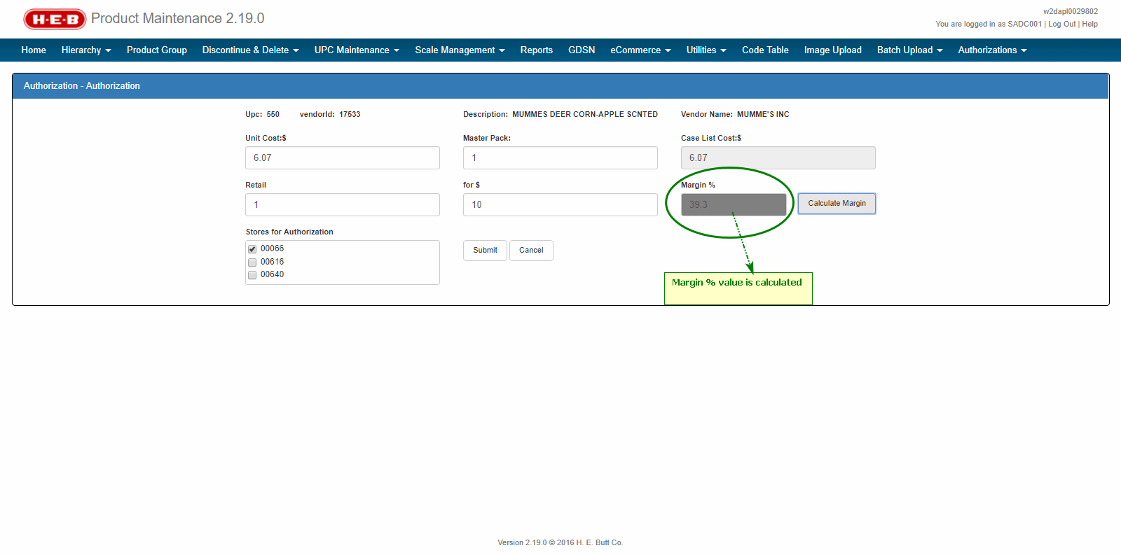
Notes:
Value of “Margin %” is calculated.

Slide 12
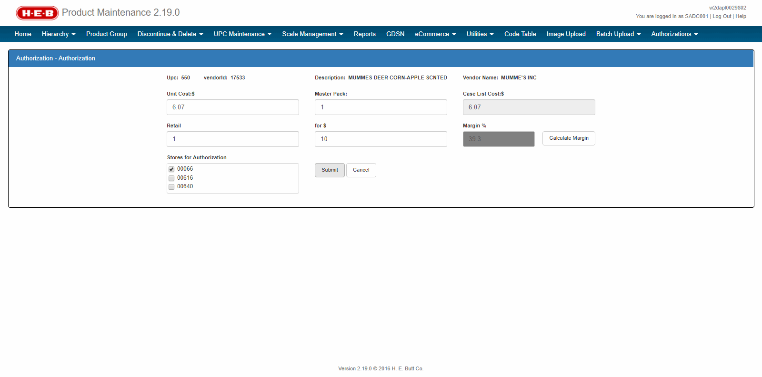
Notes:
When user clicks on “Submit” button, show a popup asking user to review the value of “Margin %”.

Slide 13
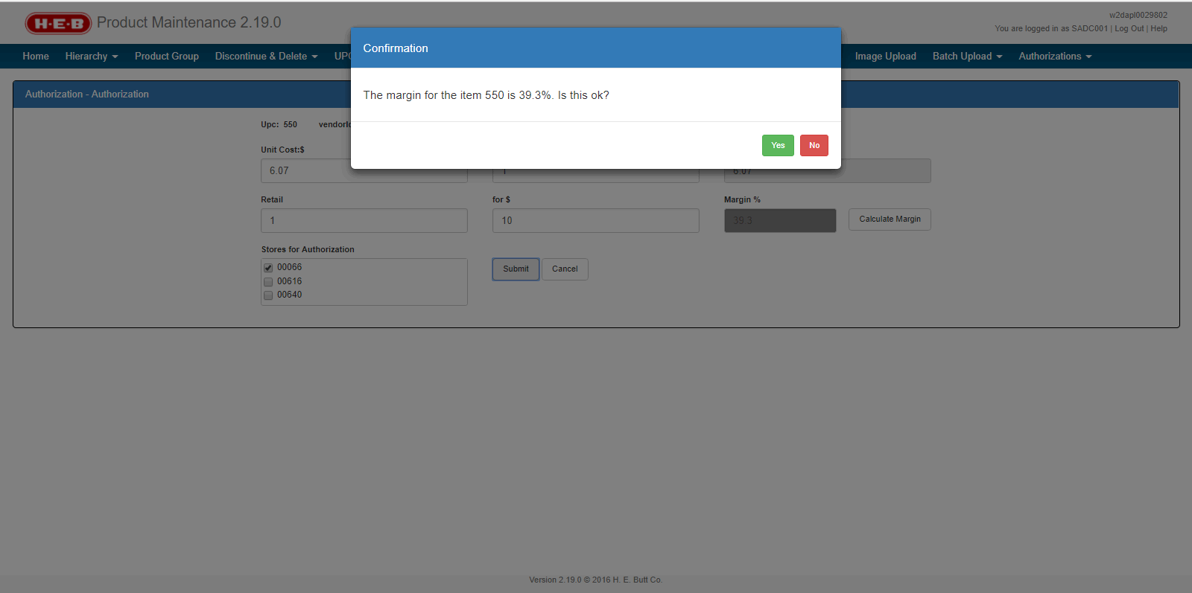
Notes:
Confirmation popup asking user to review the value of “Margin %” with Yes and No buttons.

